Slide 1
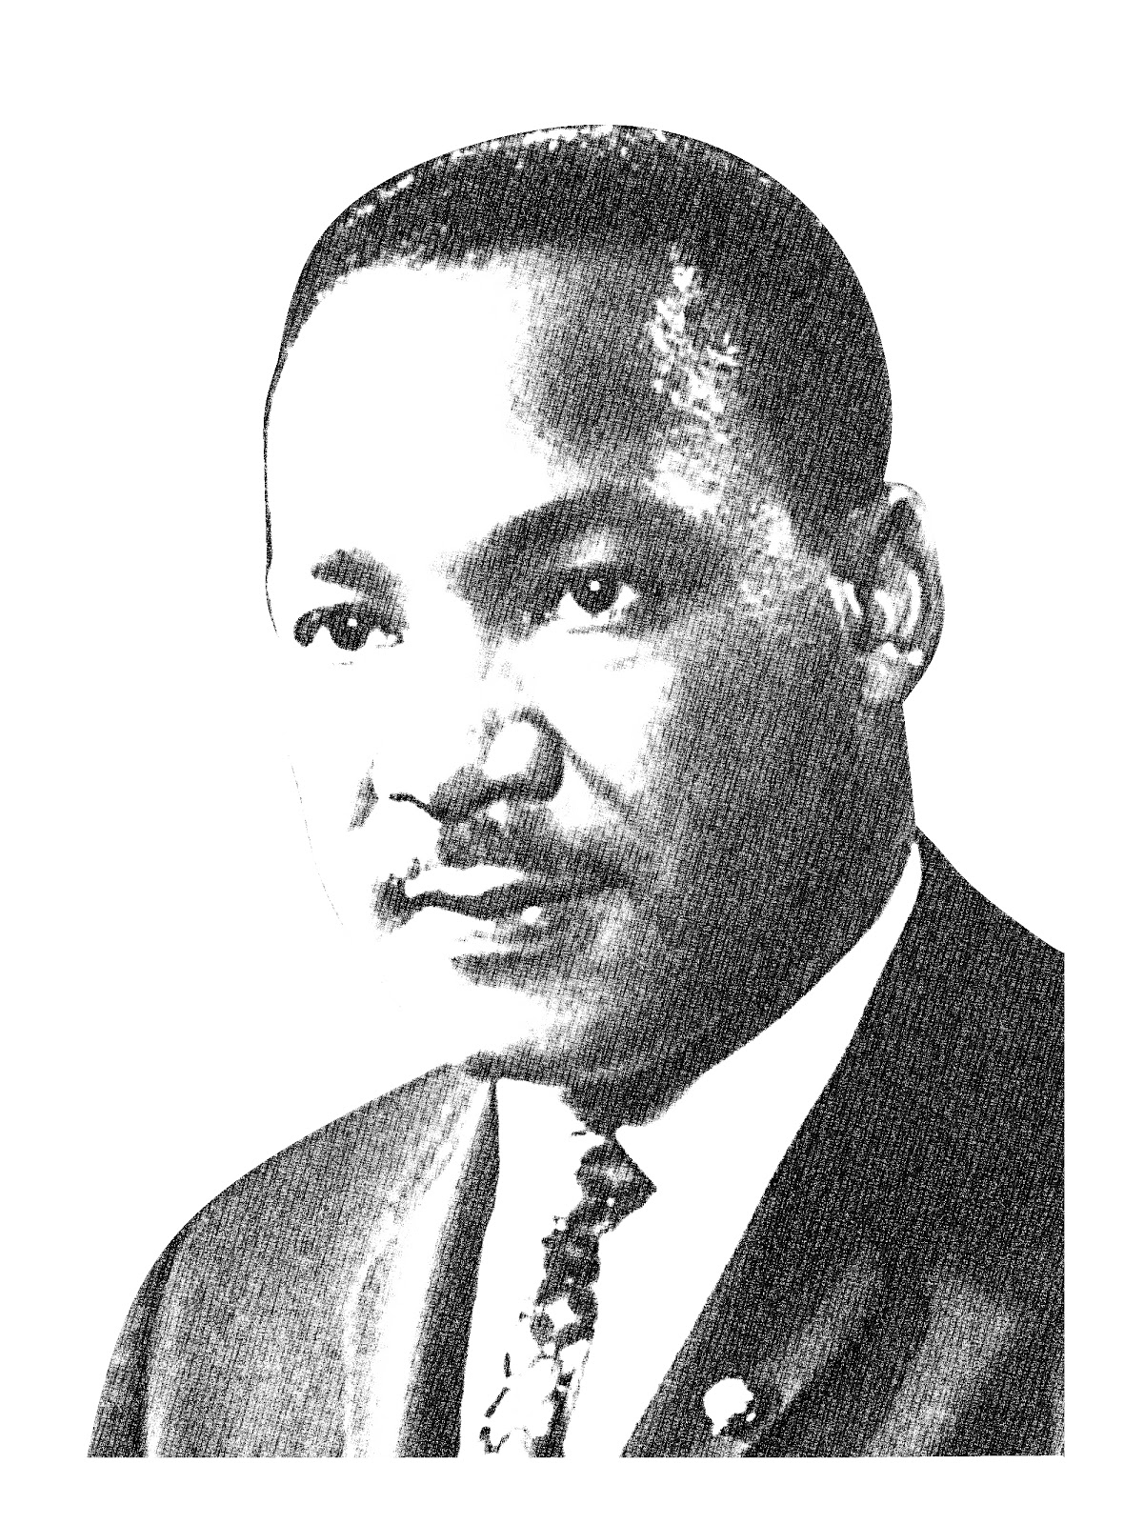
MLK: Knowledge Organiser.
CIVIL RIGHTS
This was a movement in the USA where people campaigned for equal rights for people of colour. Prior to this movement, there was total segregation in place where people of colour were not allowed to do simple things like use the same doorways/toilets/water fountains as white people.
Gandhi’s influence
Better known as the Mahatma, or great soul, Gandhi was an Indian lawyer who led his country to freedom from British colonial rule in 1947. He was assassinated months later at age 78. Gandhi is most famous for his philosophy of nonviolence that has inspired civil rights leaders around the world
Key Words
Pacifist = peace keeper
Activist = working to achieve a political change
Segregation = separation
MLK
Martin Luther King was a Christian activist. He was born in Atlanta Georgia in 1929. One of history’s greatest champions of non violence. In 1955, he responded to the incident with Rosa Parks: Montgomery Bus Boycott, this is where he became ‘known’ for being a Civil Rights Activist.
CHRISTIAN INFLUENCE
Martin Luther King was a Christian. He took very seriously Jesus’ teachings such as:
You have heard that it was said, "An eye for an eye and a tooth for a tooth." 39But I say to you, Do not resist the one who is evil. But if anyone slaps you on the right cheek, turn to him the other also. Matthew 5
“Blessed are the peacemakers, for they will be called children of God” Matthew 5

