Slide 1
How to learn and revise
Using Period 6
What does the teenage brain need to learn successfully?

Slide 2
Struggle and repetition
If the brain finds something too easy, it doesn’t learn. You need to think hard and challenge yourself to try increasingly difficult things. You also need to practise skills repeatedly to be successful.
We know what doesn’t work:
Re-reading and doing nothing else
Writing out notes and doing nothing else
Highlighting key information and doing nothing else

Slide 3
Be prepared and understand your tendencies
FACT: every single one of us is inclined to choose to do the easy option when learning. Our brains naturally opt for less struggle and challenge and we have to fight this tendency to maximise our progress when revising.
There is a load of research that backs this up!

Slide 4
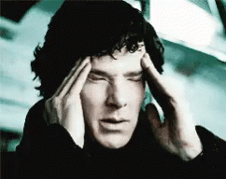
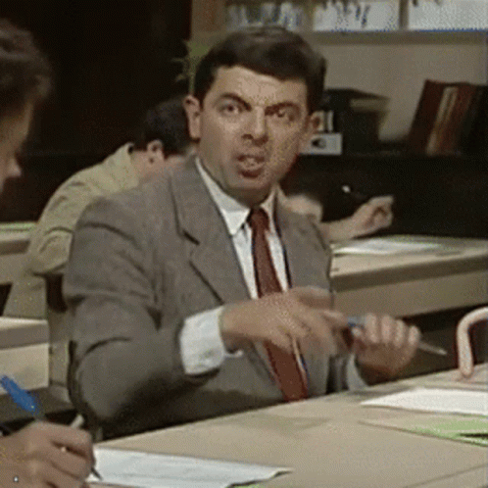
Two useful things to do in P6
Learn and memorise knowledge
Practice skills, such as, exam skills, past papers, etc.
The next slide will look at different ways to help you learn and memorise knowledge

Slide 5
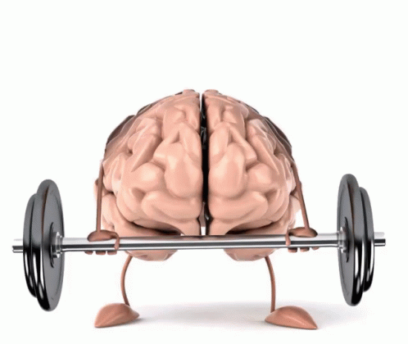
Brain Dump
Struggle to remember as much as you can (without looking at notes) about a topic and write it down.
Ways of doing this:
Use the 5522 method and blank paper - focus on a small topic
Use a blank knowledge organiser or one where you can fill in the gaps
Write out a mind map on a topic on blank paper or one with gaps to fill in

Slide 6
Quizzing
Identify the content you wish to learn and spend 5 mins reviewing it
Use your notes or a revision guide to write out some quiz questions
Close your revision guide/hide your notes and then answer the questions from memory only. Try hard to remember but leave blank spaces when you can’t remember.
Go back to your revision guide/notes and check your answers and fill in any gaps.

Slide 7
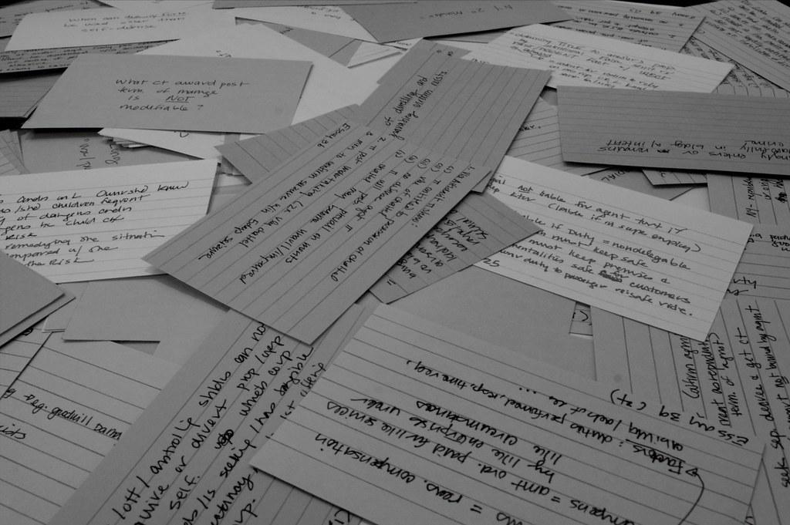
Using flashcards
Identify the topic you wish to learn
Using a revision guide or your notes, write short bullet points of key information on one side of the flashcard (or cut up pieces of paper!) - keep to only a few prompt words, no sentences
On the back of the flashcard - write out questions to answer or draw pictures as a prompt (dual coding)
Shuffle the cards (questions/pictures side up) and test yourself by answering the questions/talking through the pictures - check the back to see what you missed

Slide 8
Over to you… try one method now
Brain dump
5522
Blank KO
Mind map
Quizzing
Flashcards
Past paper practice
Exam question/essay practice
Writing practice

