Slide 1
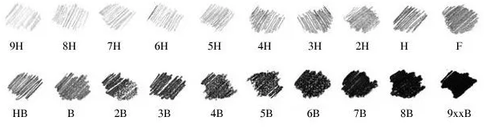
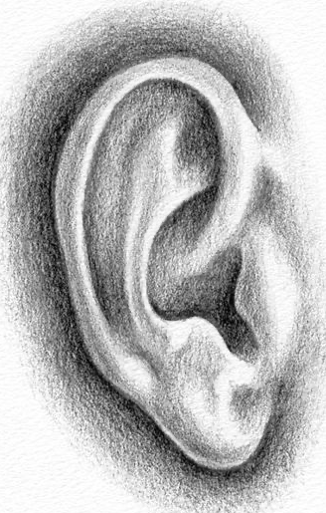
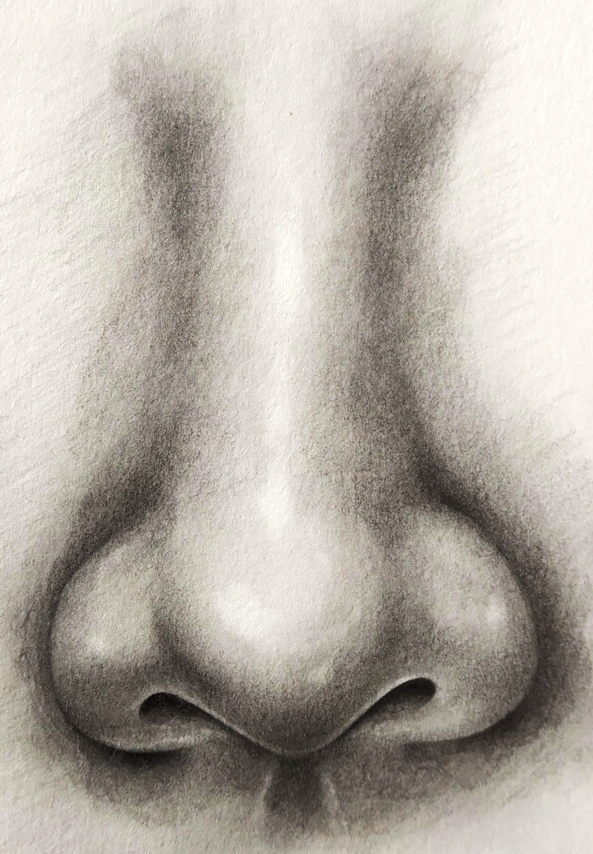
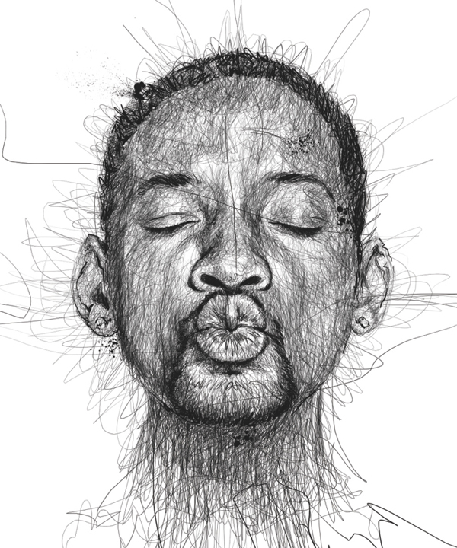
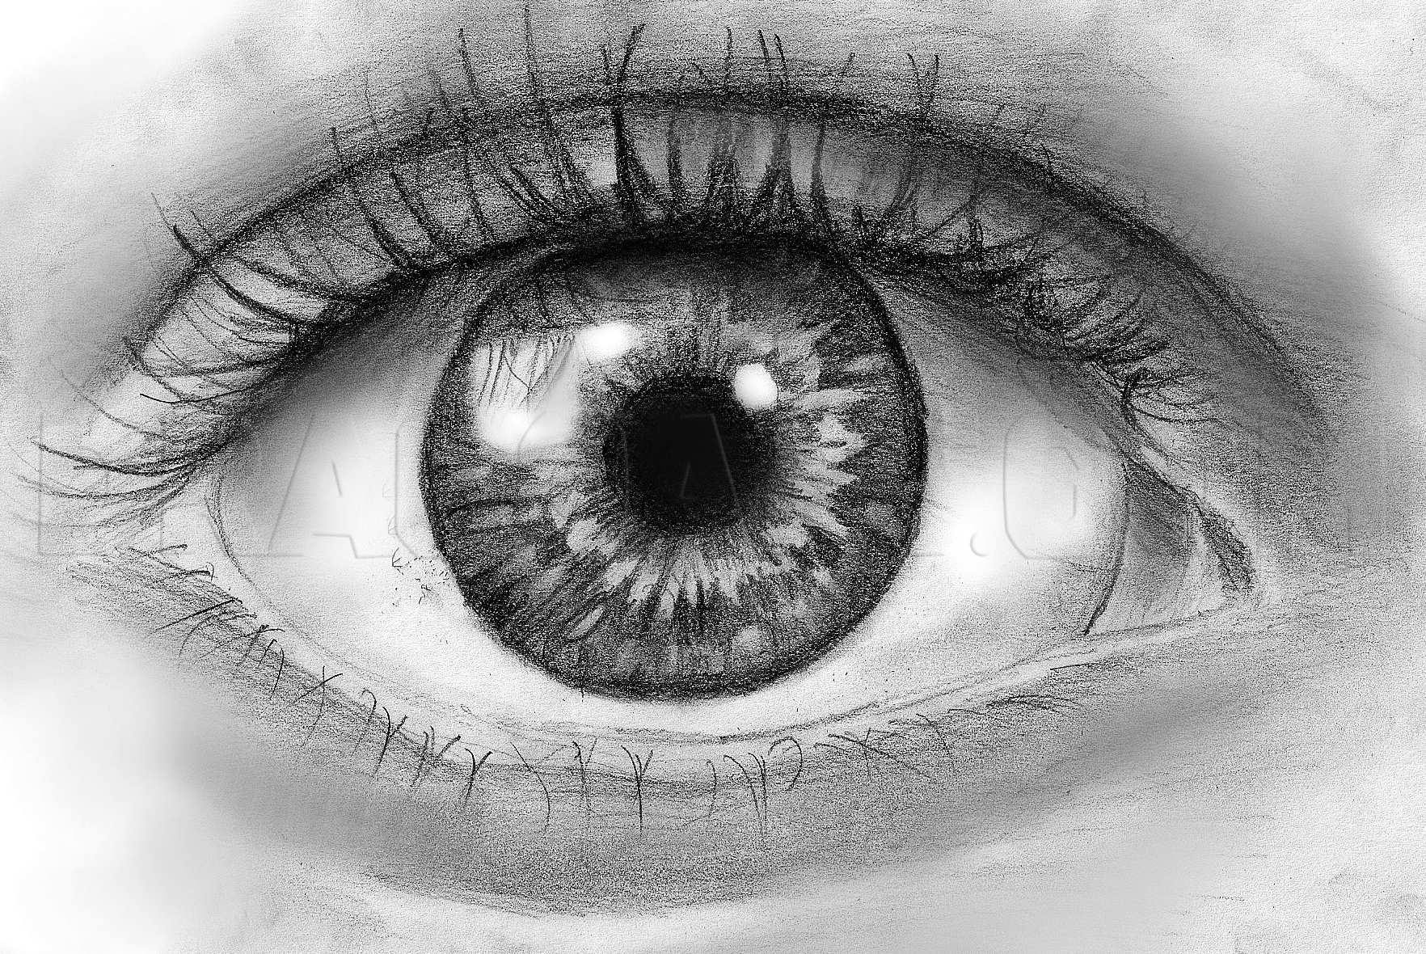
Year 9 Half term.1
Realistic portraiture
Key terms - art vocabulary
Tone | How light or dark something is, it is used to make something look 3D or realistic.
3-Dimensional | A form that shows height, width and depth
Realistic | Representing things that is true to life
Shading | Applying pressure to your pencil when moving it back and forth
Mark making | Lines, dots and dashes used to create texture
Texture | Describe how something looks or feels
Media | The material used to create the artwork
Shadows | Where the light does not hit an object, casting a shadow
Highlights | Where the light hits the object, causing it to look lighter
Guidelines | Original sketch lines that help an artist plan and map out their work to make sure it has correct proportions
Portrait | A depiction of a face like a drawing, painting or collage
Features of the face
There are different qualities of pencils, used for different purposes within art
H = Hard
B = Black
Vince Low
Shade in the same direction
Leave no white gaps
Vary the pressure on your pencil whilst shading
Use a cotton bud to blend your shading to make it smooth
S
U
C
C
E
S
S

