Slide 1
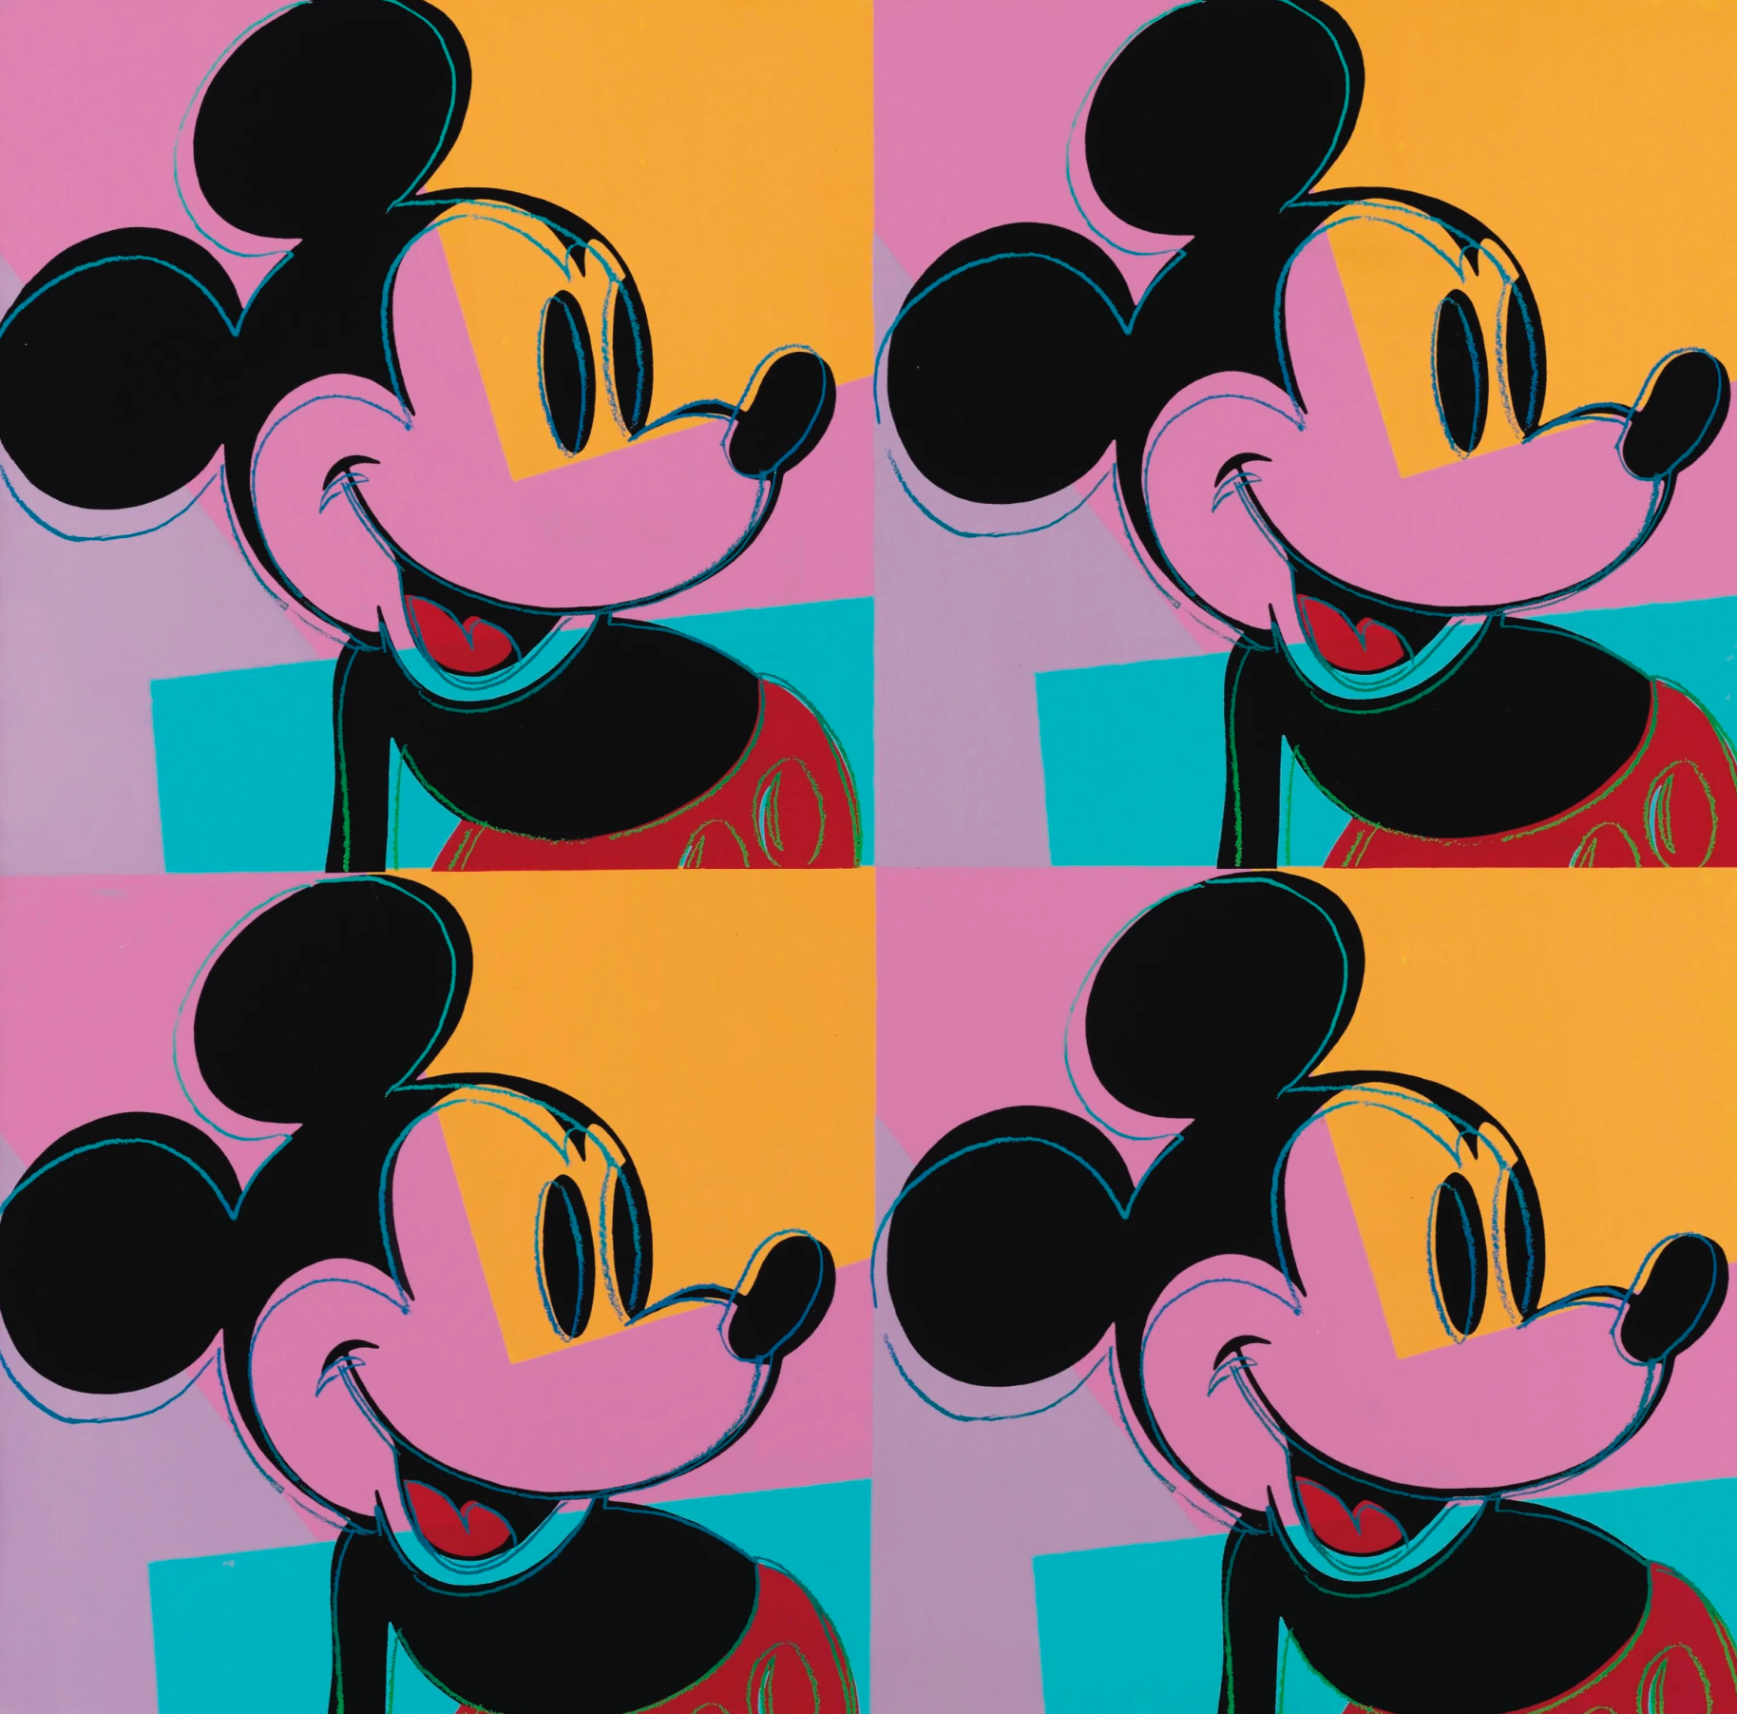
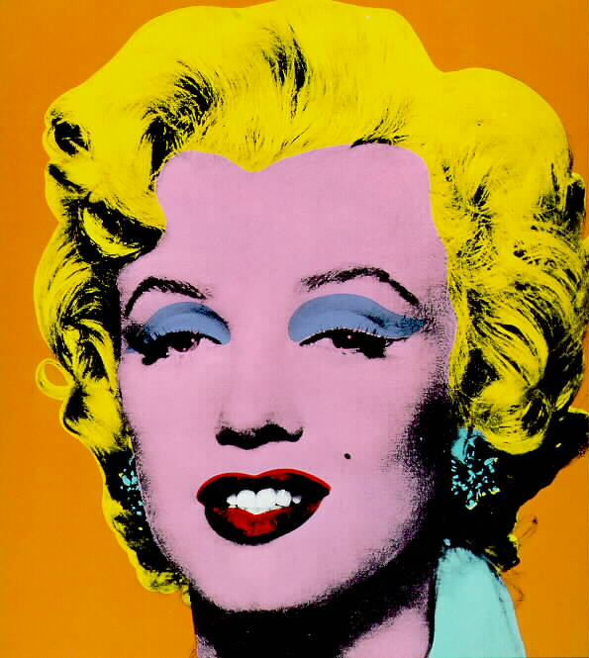
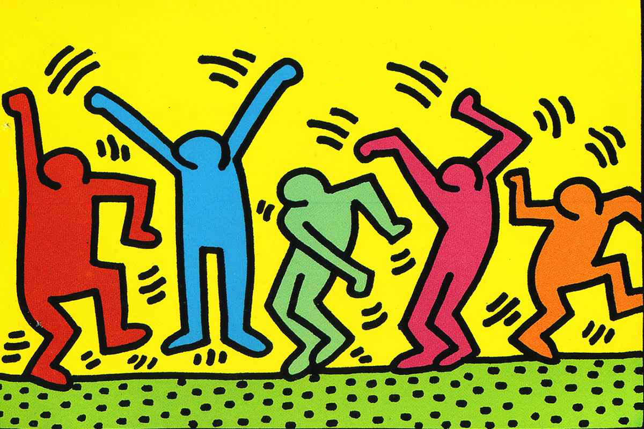
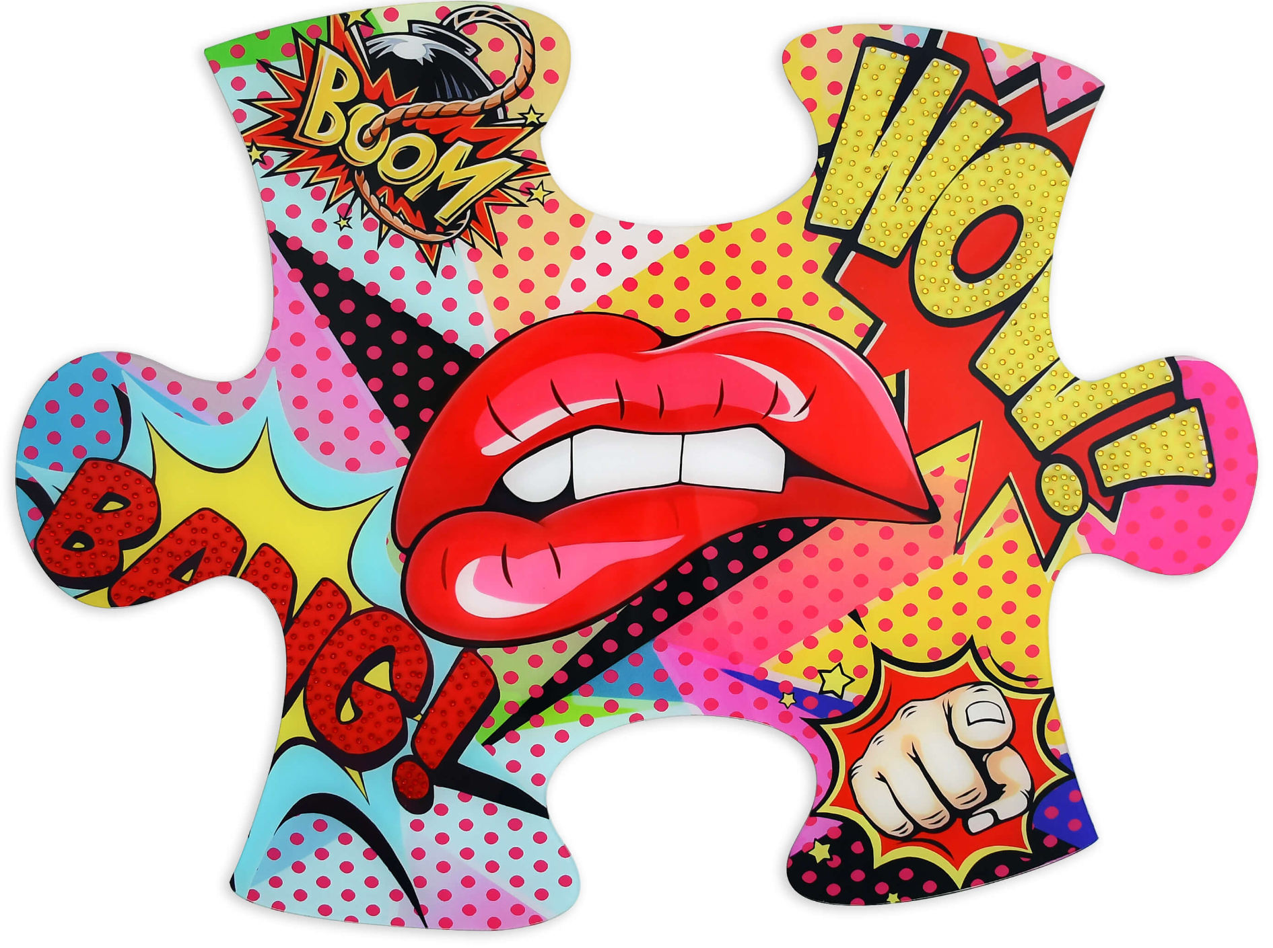
Year 8 Half term.1
POP ART
Key terms - art vocabulary
Examples of Pop Artists:
Roy Lichtenstein
Andy Warhol
Claes Oldenburg
David Hockney
Peter Blake
Patrick Caulfield
Art movement | An art movement is a style of art with a specific common goal, followed by a group of artists during a specific time period.
Pop Art movement | A movement that emerged in Britain (1950s) and America (1960s). It challenged the boundaries between ‘high traditional’ art and ‘low’ art.
Mass consumer products | Products that are bought everyday by customers. Like soap, cola, ketchup…
Ben-day dots | A commercial printing technique using small dots of colour.
Onomatopoeia | A word that is used to represent a sound.
Collage | Overlapping pieces of material, such as photographs, fabric, coloured and textured paper and other types of mixed media.
Tertiary colours | They are made by mixing a primary colour with a secondary colour
Grid method | Original photo with a grid over, a blank grid - copy box by box accurately following the shapes and lines.
Background | The part of an artwork that represents what lies behind objects in the foreground.
- Originated in Britain in the 1950s and became popular in the USA from the 1960s.
- The art movement explores mass consumer products.
- The common goal was to break the boundaries between ‘high’ art (traditional) and ‘low’ art.
- The pop art movement faded away in the 1970s.
Characteristics of Pop Art:
- Cartoon-like
- Colourful
- Simple
- Vibrant
- Everyday imagery
- Repetition

Slide 2
Year 8 Half term.1
Applying skills to the Pop Art style
Colour pencils
SUCCESS CRITERIA
SUCCESS CRITERIA
Shade in the same direction
Leave no white gaps
Press hard with your pencil to get a vibrant tone
Cut neatly
Keep your hands steady
Glue away from what you are working on
Do not add too much water to your page - it will damage it!
More water = lighter colour Less water = darker colour
Paint in the same direction
Leave no white gaps
Collage
SUCCESS CRITERIA
Do not add too much paint onto your brush
Paint in the same direction
Leave no white gaps
Watercolour paint
SUCCESS CRITERIA
Paint

